Slide 1
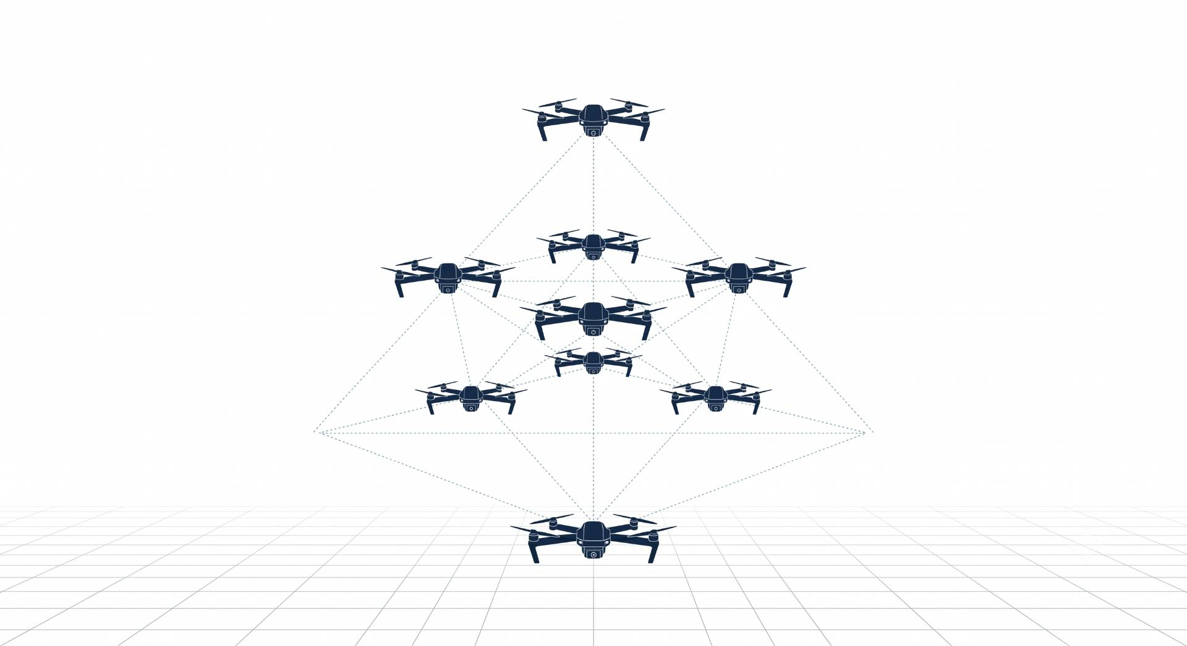

MAPPO Framework for Joint Dynamic Target Assignment and Conflict-Aware Collision Avoidance in Multi-UAV Systems
Ayesha Khalil, CIIT/SP25-RCS-009/ATD
Supervisor: Dr. Faisal Rehman Co-supervisor: Dr. Ehzaz Mustafa

Slide 2
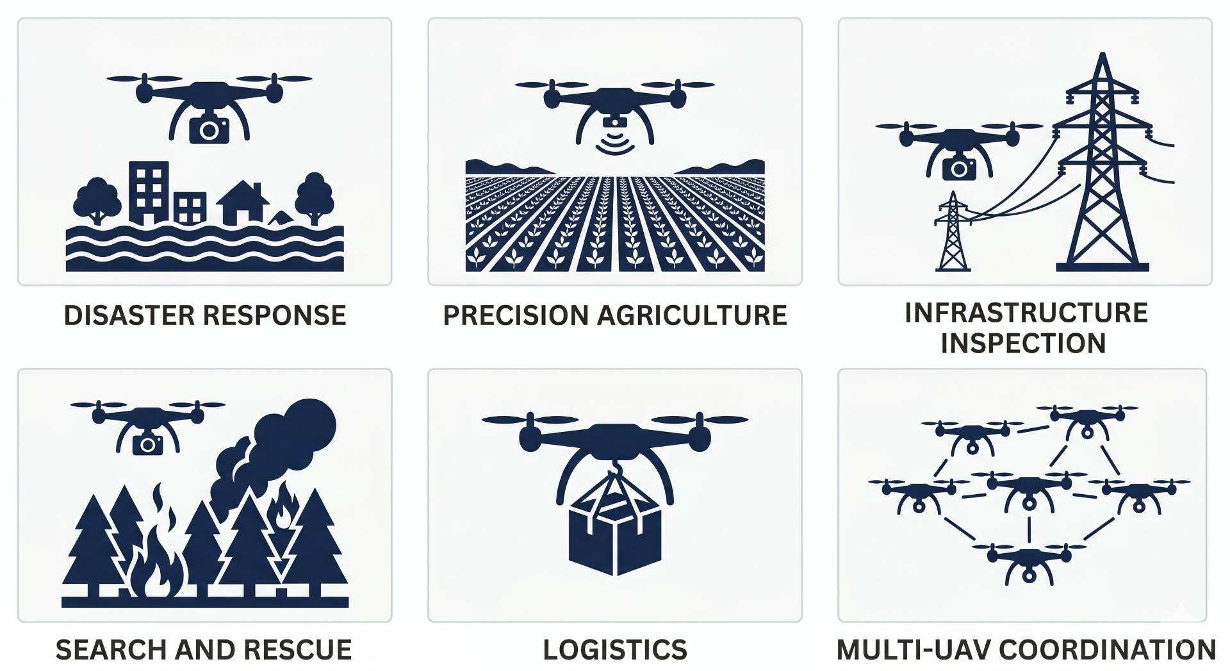
Introduction: Why UAVs?
From military tools to critical civilian infrastructure
UAVs are frequently used in disaster response, agriculture and inspection.
Single drone cannot cover complex and large-scale missions.
Teams of drones are faster, redundant and more effective.
Hardware is ready, coordination is the unsolved problem.

Slide 3
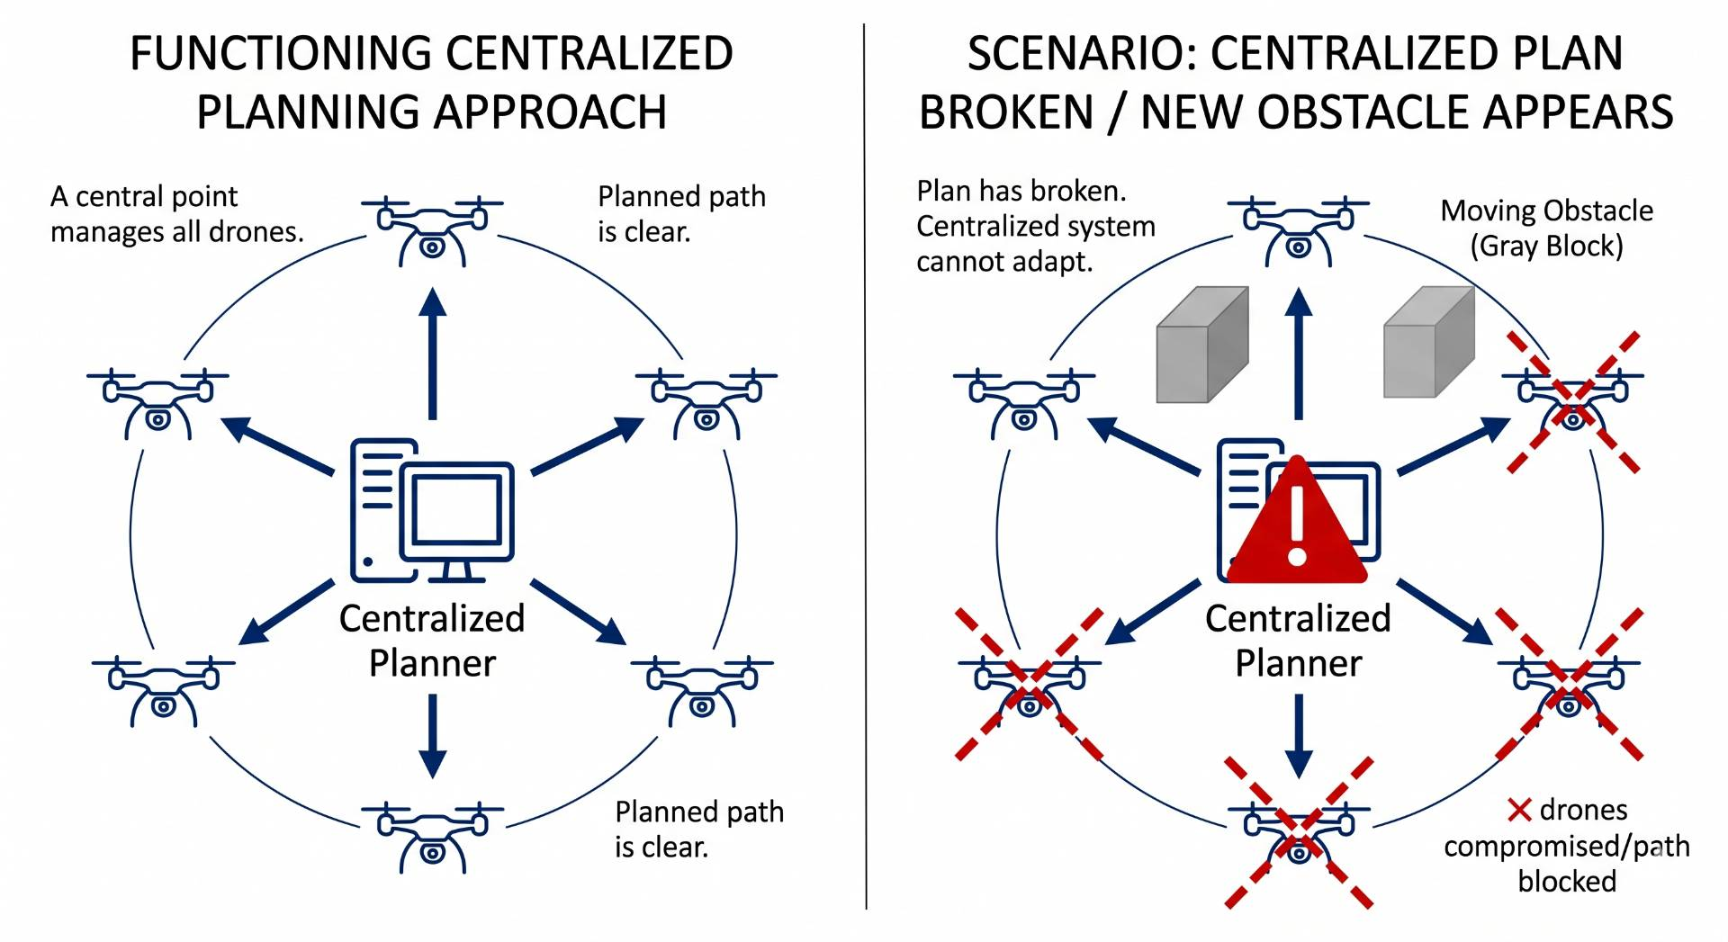
Introduction: Multi-UAV Coordination
Multiple drones, shared airspace, conflicting decisions
Classical planners compute one global solution, too slow.
Dynamic environments break pre-planned paths instantly.
Drones need to adapt in real-time independently.
Solution: let drones learn coordination through experience.

Slide 4
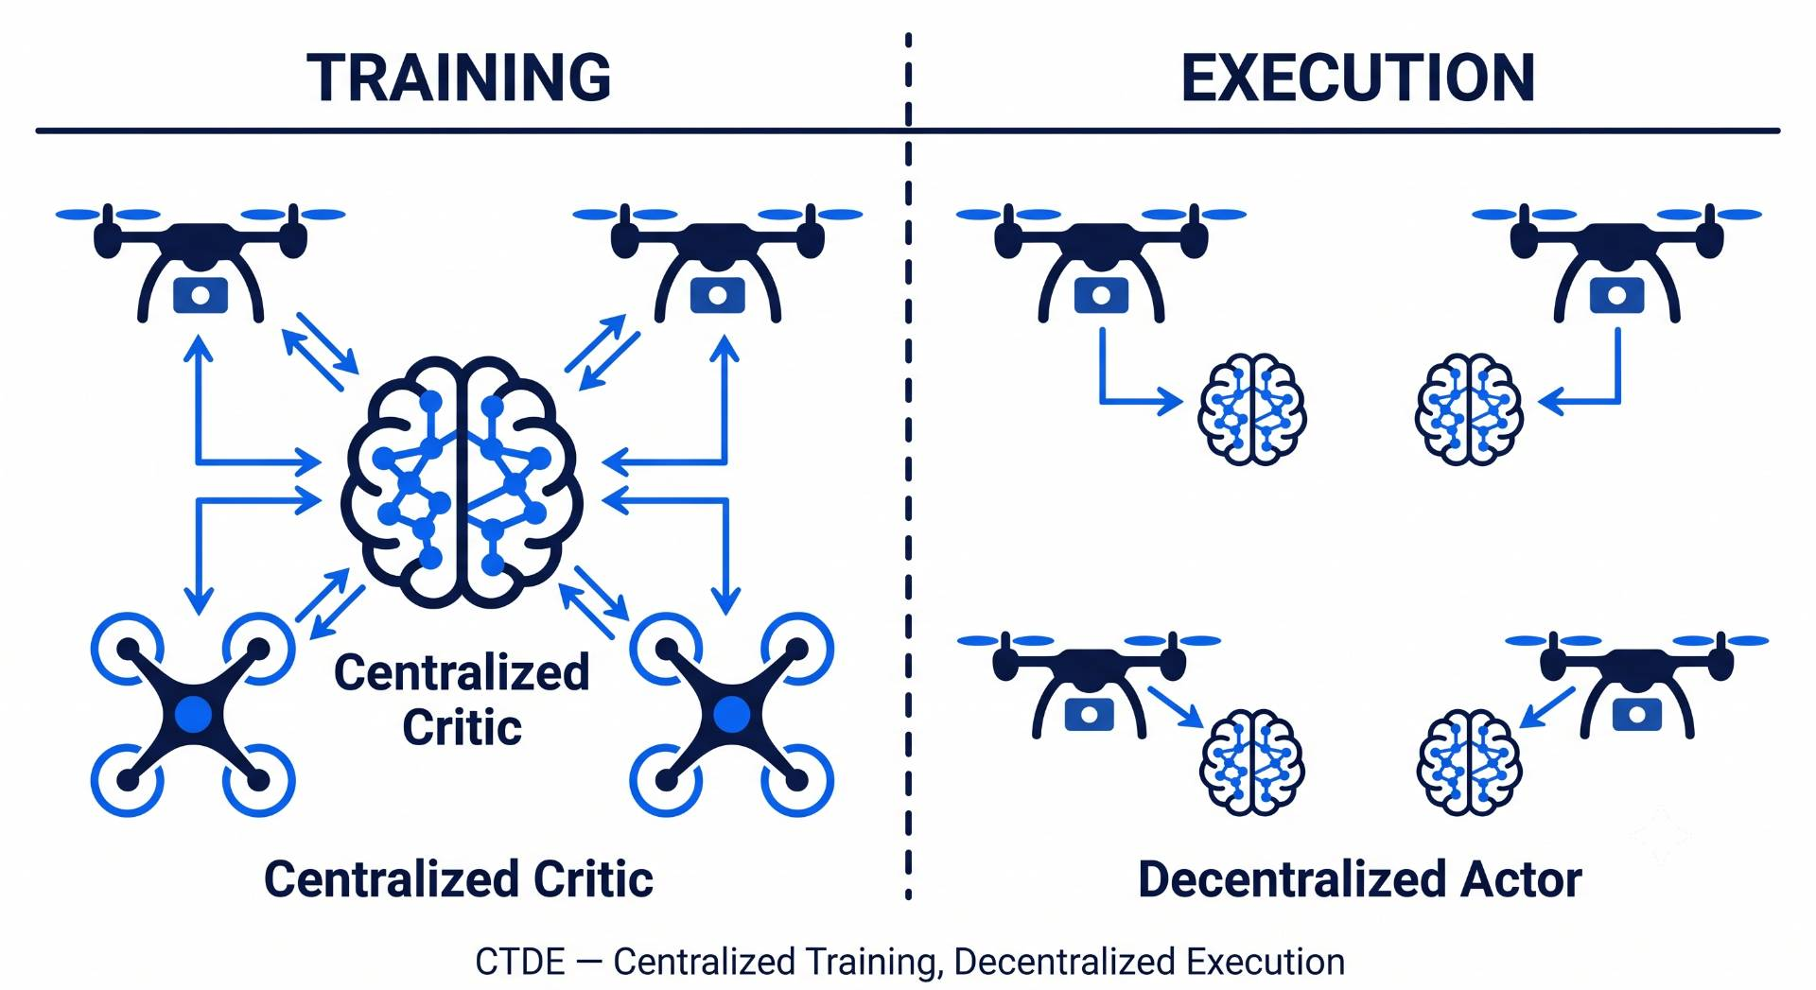
Introduction: DRL & MARL
Learning-based coordination how it works
DRL: agent receives reward, learns optimal policy.
MARL: extends DRL to teams of cooperating agents.
CTDE Architecture: train with shared info, execute independently.
MAPPO (Multi-Agent PPO): best-performing cooperative MARL algorithm.

Slide 5
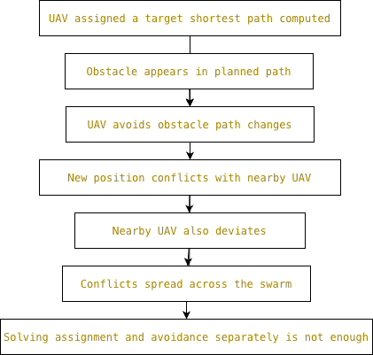
Motivation:
Why Joint Optimization?
One obstacle, swarm-wide conflict.
Assignment and avoidance are coupled.
Separate solutions are not enough.

Slide 6
Related Work:
.
Author | Method | Dynamic Obstacles | Target Assignment | Collision Avoidance | Path Optimization | Weights
Tang et al. [1] | Improved D3QN | ✓ | ✗ | ✗ | ✓ | Fixed
Kong et al. [2] | TANet-TD3 | ✓ | ✓ | ✗ | ✓ | Fixed
Jarray et al. [3] | Dynamic Reward DQN | ✓ | ✗ | ✗ | ✓ | Dynamic
Zhang et al. [4] | Mean-Field DDPG | ✗ | ✗ | ✗ | ✓ | Fixed
Poudel & Moh [5] | MAML-MARL | ✓ | ✗ | ✗ | ✗ | Fixed
Rezaee et al. [6] | IGAT-MARL | ✓ | ✗ | ✓ | ✗ | Fixed
Sheng et al. [7] | DA-MAPPO | ✗ | ✓ | ✗ | ✓ | Fixed

Slide 7
Gap in existing work:
Assignment only: UAV reaches target but collides with other UAVs.
Avoidance only: UAV avoids collision but target stays uncovered.
Both together with fixed weights, one always overrides the other.
No framework learns when assignment must lead and when avoidance must lead.

Slide 8
Problem Statement:
In multi-UAV missions, task allocation and collision avoidance are inherently interdependent, as assignment decisions influence trajectories and avoidance maneuvers can invalidate assigned tasks. This coupling can lead to uncovered targets, reassignment conflicts and new collision risks .

Slide 9
Research Objective
Design a learned mechanism to balance assignment and avoidance jointly.
Test scalability across 3, 5, and 8 drones.
Compare learned α against fixed reward weights.
Find where and how the framework fails.

Slide 10
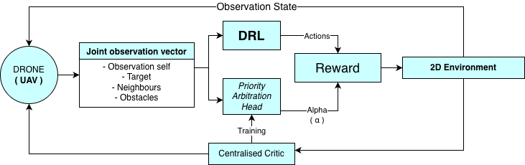
Proposed Methodology:
.

Slide 11
References:
[1] J. Tang, Y. Liang, and K. Li, "Dynamic scene path planning of UAVs based on deep reinforcement learning," Drones, vol. 8, no. 2, p. 60, 2024.
[2] X. Kong, Y. Zhou, Z. Li, and S. Wang, "Multi-UAV simultaneous target assignment and path planning based on deep reinforcement learning in dynamic multiple obstacles environments," Front. Neurorobot., vol. 17, p. 1302898, 2024.
[3] R. Jarray, I. Zaghbani, and S. Bouallègue, "Dynamic reward-based deep reinforcement learning algorithm for UAV path planning in large-scale environments," Procedia Comput. Sci., vol. 270, pp. 692-702, 2025.
[4] Y. Zhang et al., "Large-scale UAV swarm path planning based on mean-field reinforcement learning," Chin. J. Aeronaut., vol. 38, no. 9, p. 103484, 2025.
[5] S. Poudel and S. Moh, "MAML-integrated multi-agent reinforcement learning for adaptive coalition-based UAV coordination in disaster scenarios," Internet of Things, vol. 37, p. 101930, 2026.
[6] M. R. Rezaee et al., "Efficient multi-agent deep reinforcement learning algorithm for multi-UAV collision avoidance," Appl. Soft Comput., vol. 197, p. 115145, 2026.
[7] Y. Sheng, X. Xie, H. Liu, and J. Li, "Dynamic target assignment and cooperative decision-making for UAV swarms based on multi-agent reinforcement learning," IEEE Internet Things J., doi: 10.1109/JIOT.2026.3686066, 2026.

Slide 12
Thank you!

